Slide 1
SQL 2
Hunter Bartlett

Slide 2
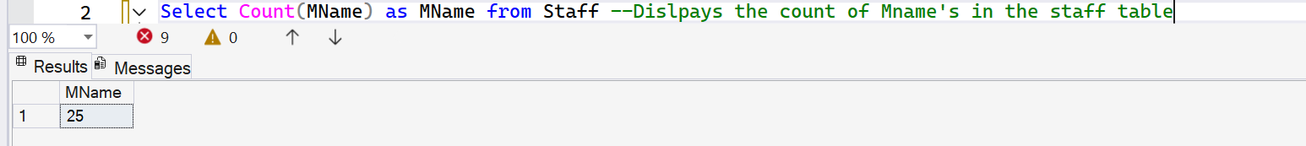
1. Display the count of the number of rows in a table.

Slide 3
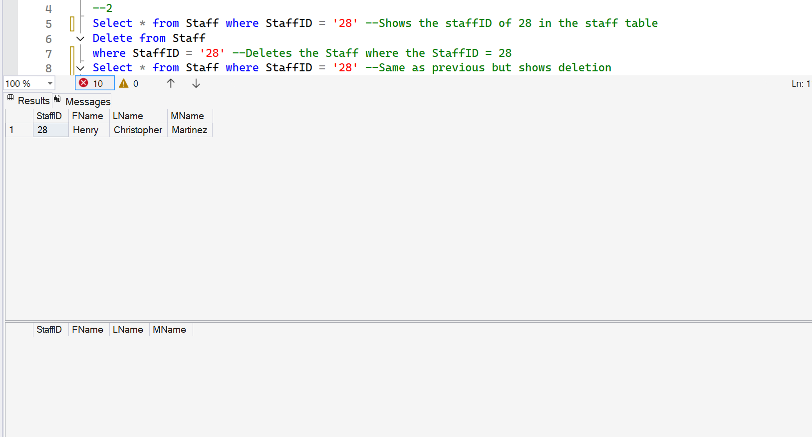
2. Delete a specified record in a table and prove that it is deleted.

Slide 4
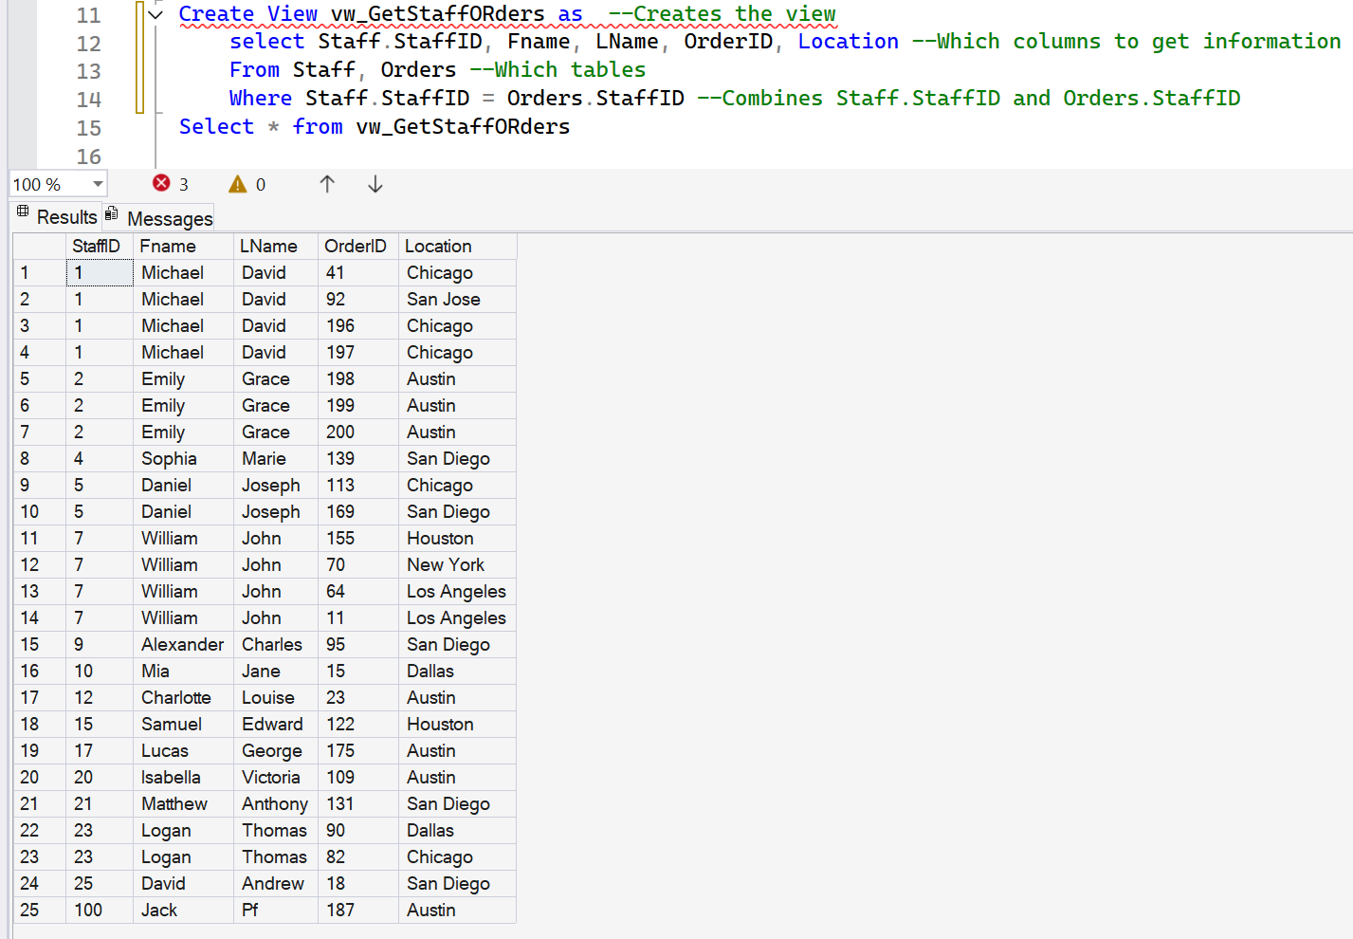
3. Two table join that creates a view.

Slide 5
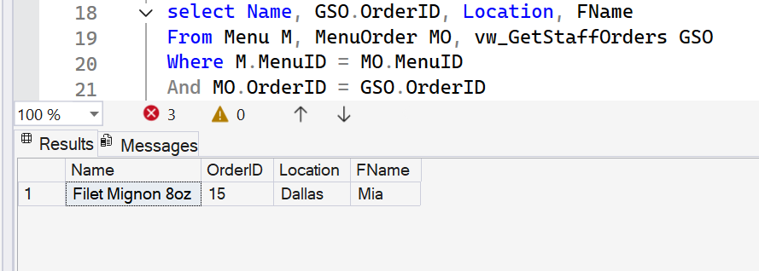
4. Three table join qualified with a key value from one view and one other table.

Slide 6
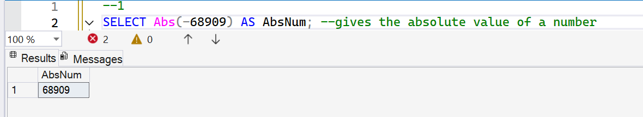
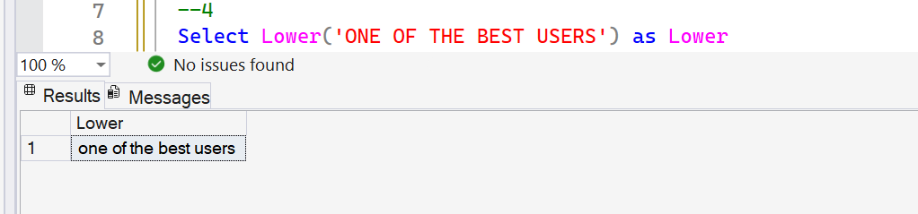
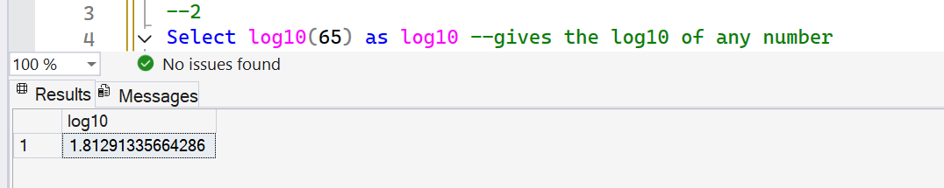
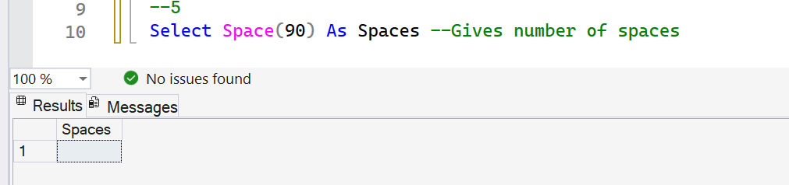
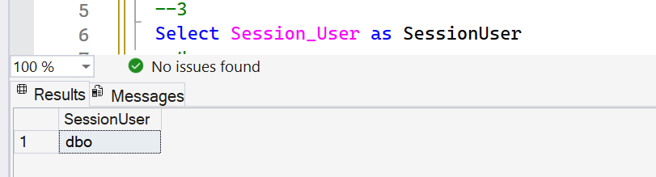
5. Use five SQL functions (such as SUM). This should be five queries with at least one function for each query and not the same functions as you used in previous assignments.

Slide 7
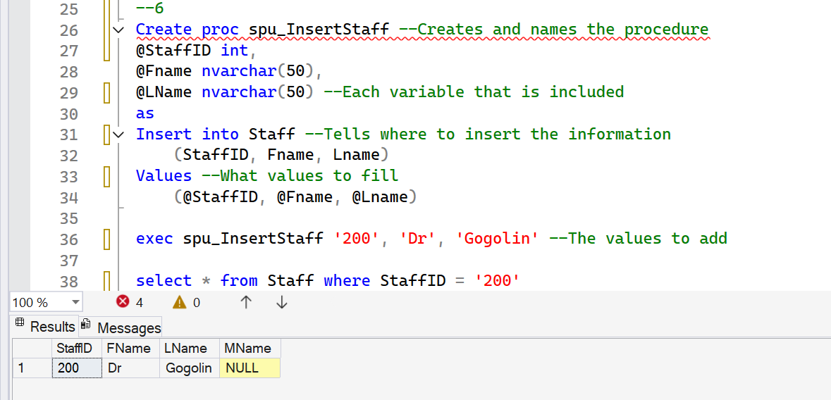
6. Create a SQLstored procecdure to insert values into a row using variables passed in on execution.

Slide 8
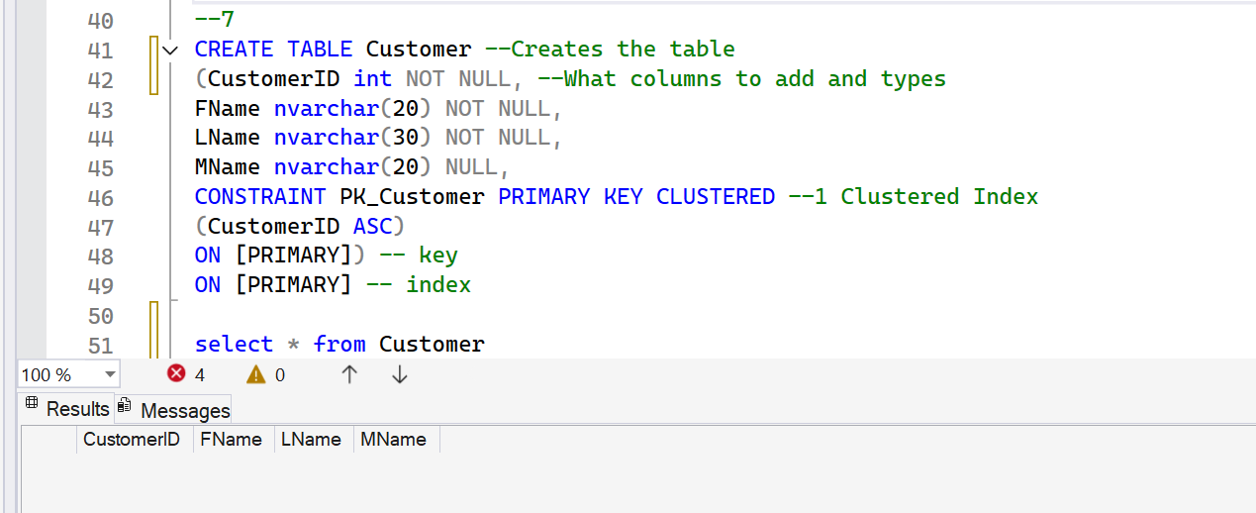
7. Write the SQL to create a table, key, and index. This must not be generated SQL.

Slide 9
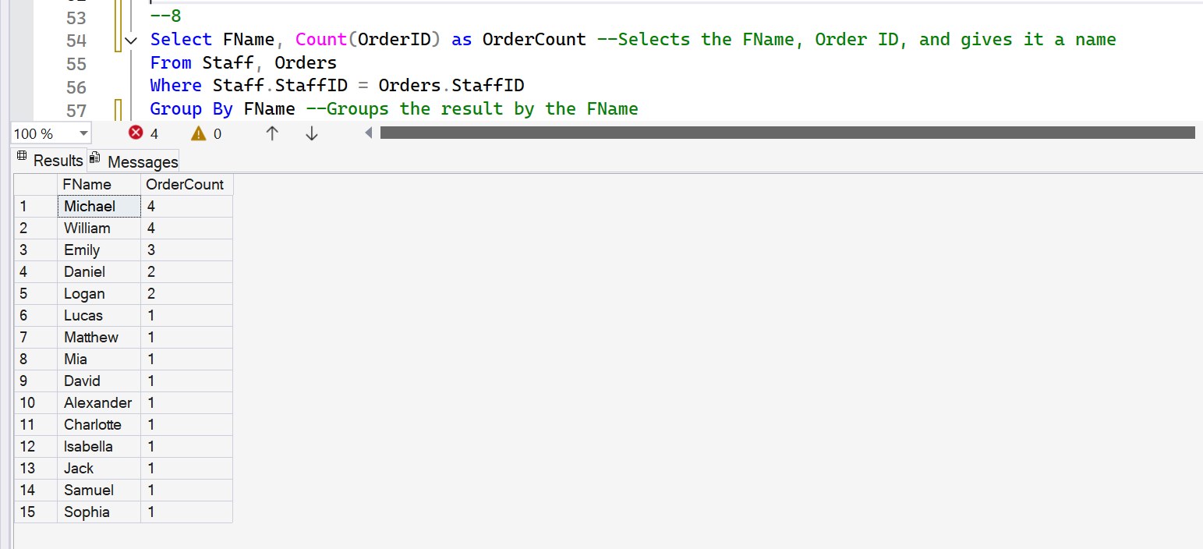
8. Create a query that uses Group By

Slide 10
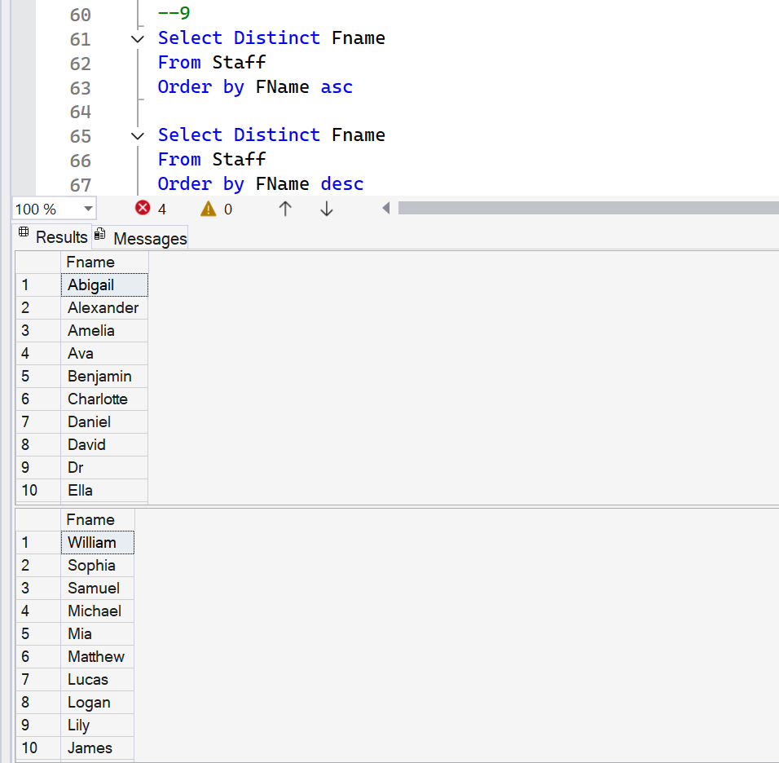
9. Demonstrate the use of distinct, ascending, descending in a query. The result set must have at least 7 rows.

Slide 11
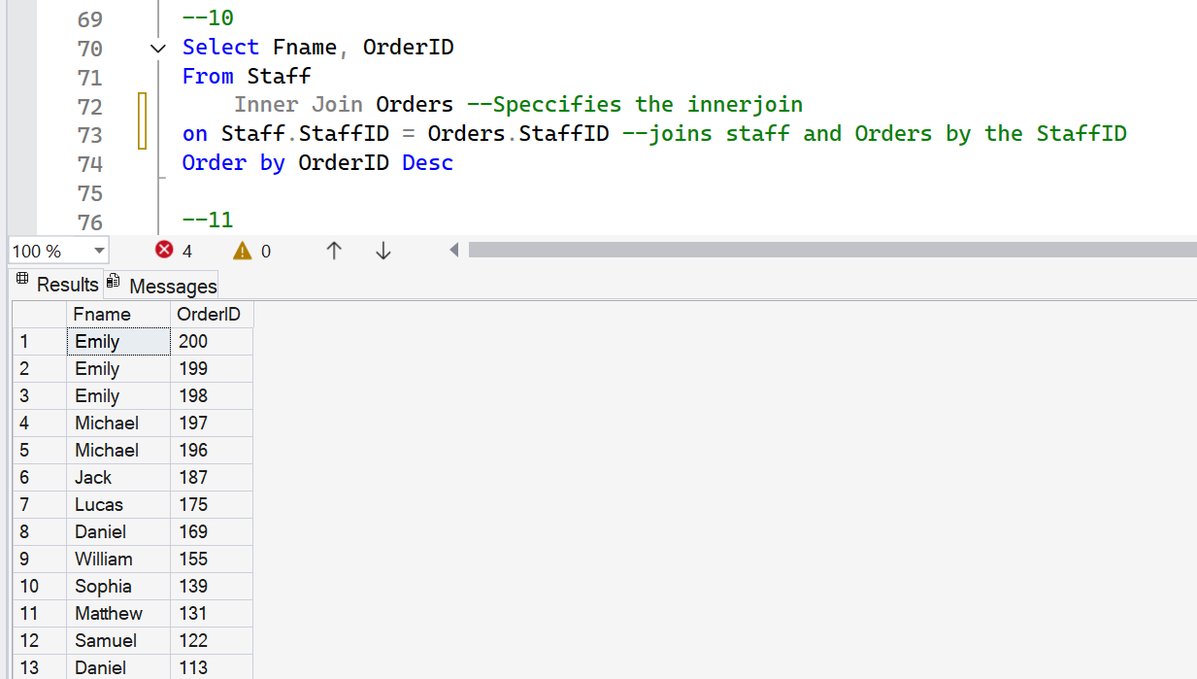
10. Create a query that demonstrates an inner join (includes join in statement)

Slide 12
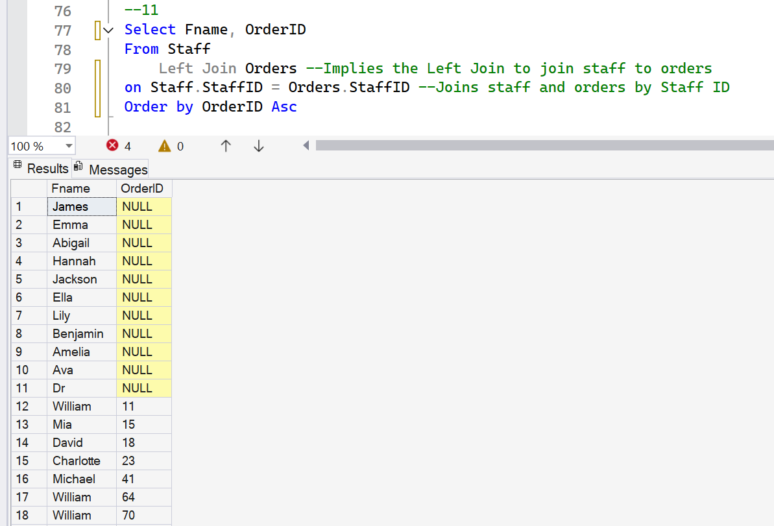
11. Create a query that demonstrates a left outer join (includes join in statement)

Slide 13
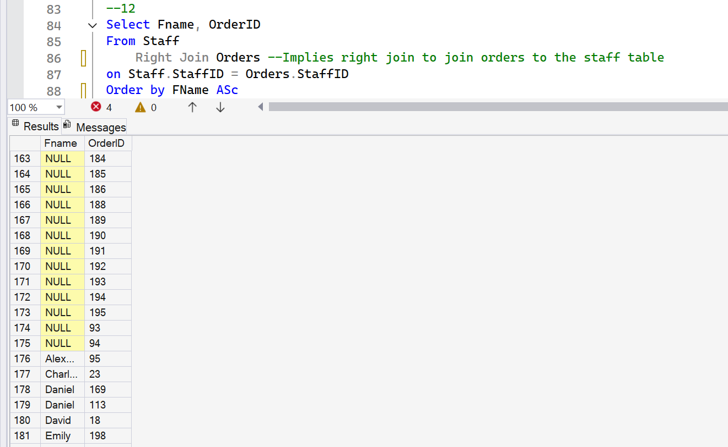
12. Create a query that demonstrates a right outer join (includes join in statement)

